Slide 1
Chapter 2:
Operating System Structures

Slide 2
Outline
Outline
Operating System Services
User Operating System Interface
System Calls
System Programs
Operating System Structure
Objectives
To describe the services an operating system provides to users, processes, and other systems
To discuss the various ways of structuring an operating system

Slide 3
Operating System Services
1) One set of operating-system services provides functions that are helpful to the user:
  User interface: GUI or command line (in or out of kernel)
  Program execution: load a program and start running, terminate
  I/O operations: file or device I/O
  File-system manipulation: file concept and operations
  Communication: process communication
  Error detection and handling – OS needs to be constantly aware of possible errors

Slide 4
Operating System Services
2) Another set of OS functions exists for ensuring the efficient operation of the system itself via resource sharing
  Resource allocation: allocate resources to users and processes
    CPU, Memory, File Storage, I/O devices, etc.
  Accounting: which users/process used which resource, how much
  Protection and security:
    enable owner of information or resources to define what can be accessed and by whom
    Concurrent process should not harm each other
    access control to resources, authentication, …

Slide 5

OS Services

Slide 6
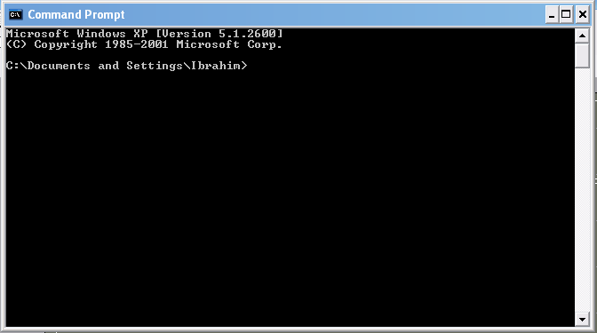
[User - Operating System] Interface - CLI
CLI: Command Line Interface (CLI) or command interpreter (shell)
  in kernel or as a system program,
  Many flavors
  fetches a command from user and executes it
    Command may be built-in,
    Command may be another program
GUI: User-friendly desktop interface
  Icons represent files, programs, actions, etc.
Many operating systems now include both CLI and GUI interfaces
  Linux: command shells available (CLI); KDE as GUI

Slide 7
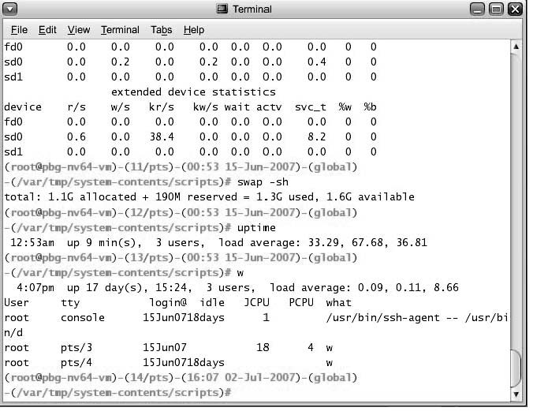
Bourne Shell Command Interpreter

Slide 8

The MacOS X GUI

Slide 9
System Calls
Programming interface to the services provided by the OS
  i.e. interface provided to applications
Typically written in a high-level language (C or C++)
Are called by a running program to get services
Even a simple program may make a lot of calls per second.

Slide 10
System Calls
Application
(a process, a
running program)
Application
System Call Interface
….
System Calls
(OS functions)
Each has a name/number, set of parameters
Other kernel functions
Kernel/OS
other kernel functions can be called by system calls

Slide 11

Example of System Calls
System call sequence to copy the contents of one file to another file

Slide 12

System Call Implementation and Calling
Typically,
  a number associated with each system call
  Number used as an index to a table: System Call table
  Table keeps addresses of system calls
  System calls run and returns
Caller does not know system call implementation
  Just should know interface

Slide 13
Accessing and executing System Calls
System calls typically not accessed directly by programs
Mostly accessed by programs via a high-level Application Program Interface (API) (i.e. a library) rather than direct system call use
Three most common APIs are :
  Win32 API for Windows,
  POSIX API for POSIX-based systems (including virtually all versions of UNIX, Linux, and Mac OS X),
  Java API for the Java virtual machine (JVM)
Program
API (std lib)
OS
Sys Calls
Rest of Kernel

Slide 14

Example of Standard API
Consider the ReadFile() function in the Win32 API—a function for reading from a file
A description of the parameters passed to ReadFile()
  HANDLE file—the file to be read
  LPVOID buffer—a buffer where the data will be read into and written from
  DWORD bytesToRead—the number of bytes to be read into the buffer
  LPDWORD bytesRead—the number of bytes read during the last read
  LPOVERLAPPED ovl—indicates if overlapped I/O is being used

Slide 15
Why use APIs rather than system calls directly?
Your Program
…
fd =open(…);
….
Your Program Code
user level code
API
open (…)
{…}
fopen(…)
{…}
Standard C library
Code
System Calls
sys_open (…)
{…}
Kernel Code
kernel level code

Slide 16

Standard C Library Example
C program invoking printf() library call, which calls write() system call

Slide 17
Linux system calls
around 300-400 system calls
Number | Generic Name of System Call | Name of Function in Kernel
1 | exit | sys_exit
2 | fork | sys_fork
3 | read | sys_read
4 | write | sys_write
5 | open | sys_Open
6 | close | sys_Close
…
39 | mkdir | sys_Mkdir
…

Slide 18
Linux system calls and
Intel x86 architecture
Calling a System Call
CPU
Move system call number
Move some parameters
Execute TRAP instruction
int $0x80
eax
ebx
ecx
CPu registers

Slide 19
System Call Parameter Passing
Often, more information is required than the identity of the desired system call
  Exact type and amount of information vary according to OS and call
Three general methods used to pass parameters to the OS
  1) Simplest: pass the parameters in registers
    In some cases, may be more parameters than registers
  2) Parameters stored in a block, or table, in memory, and address of block passed as a parameter in a register
  3) Parameters placed, or pushed, onto the stack by the program and popped off the stack by the operating system
  Last two methods do not limit the number or length of parameters being passed

Slide 20

Parameter Passing via Table

Slide 21
Types of System Calls
Process control
File management
Device management
Information maintenance
Communications
Protection

Slide 22

Examples of Windows and Unix System Calls

Slide 23
System Programs
System programs provide a convenient environment for program development and execution. They can be divided into:
  File manipulation (create, delete, copy, rename, print, list, …)
  Status information (date, time, amount of available memory, disk space, who is logged on, …)
  File modification (text editors, grep, …)
  Programming language support (compiler, debuggers, …)
  Program loading and execution (loaders, linkers)
  Communications (ftp, browsers, ssh, …)
  Other System Utilities/Applications may come with OS CD (games, math solvers, plotting tools, database systems, spreadsheets, word processors, …)

Slide 24
System Programs
Most users’ view of the operation system is defined by system programs, not the actual system calls
System programs provide a convenient environment for program development and execution
  Some of them are simply user interfaces to system calls; others are considerably more complex
    create file: simple system program that can just call “create” system call or something similar
    compiler: complex system program

Slide 25
System Programs
Users (People)
System Programs
Other User Applications
System Calls
Kernel
From OS’s view: system+user programs are all applications

Slide 26
Structuring OS (Kernel)

Slide 27
OS Structure
Simple Structure (MSDOS)
Layered Approach
Microkernel Approach
Modules Approach

Slide 28

Simple Structure
MS-DOS – written to provide the most functionality in the least space
  Not divided into modules
  Although MS-DOS has some structure, its interfaces and levels of functionality are not well separated

Slide 29
Layered Approach
The operating system is divided into a number of layers (levels), each built on top of lower layers. The bottom layer (layer 0), is the hardware; the highest (layer N) is the user interface.
With modularity, layers are selected such that each uses functions (operations) and services of only lower-level layers

Slide 30
Unix
UNIX – limited by hardware functionality, the original UNIX operating system had limited structuring. The UNIX OS consists of two separable parts
  Systems programs
  The kernel
    Consists of everything below the system-call interface and above the physical hardware
    Provides the file system, CPU scheduling, memory management, and other operating-system functions; a large number of functions for one level

Slide 31

Traditional UNIX System Structure

Slide 32

Layered Operating System

Slide 33
Microkernel System Structure
Moves as much from the kernel into “user” space
Communication takes place between user modules using message passing
Benefits:
  Easier to extend a microkernel
  Easier to port the operating system to new architectures
  More reliable (less code is running in kernel mode)
  More secure
Detriments:
  Performance overhead of user space to kernel space communication

Slide 34
Modules
Most modern operating systems implement kernel modules
  Uses object-oriented approach
  Each core component is separate
  Each talks to the others over known interfaces
  Each is loadable as needed within the kernel
Overall, similar to layers but more flexible
Linux supports modules

Slide 35

Solaris Modular Approach

Slide 36
Virtual Machines
Hardware is abstracted into several different execution environments
  Virtual machines
Each virtual machine provides an interface that is identical to the bare hardware
A guest process/kernel can run on top of a virtual machine.
  We can run several operating systems on the same host.
  Each virtual machine will run another operating system.

Slide 37
Virtual Machines
processes
processes
processes
processes
Guest
OS
Guest
OS
Guest OS
VM1
VM2
VM3
Virtual Machine Implementation
Host Operating System
Hardware

Slide 38
Examples
VMware
  Abstracts Intel X86 hardware
Java virtual machine
  Specification of an abstract computer
.NET Framework

Slide 39
Operating System Debugging
Failure analysis
  Log files
  Core dump
  Crash dump
Performance tuning
  Monitor system performance
    Add code to kernel
    Use system tools like “top”
DTrace
  Facility to dynamically adding probes to a running system (both to processes and to the kernel)
  Probes can be queries using D programming language to obtain info

Slide 40
Operating System Generation
Configure the kernel
Compile the kernel

Slide 41
System Boot
Bootstrap program (loader) locates the kernel, loads it and starts the kernel.
  This can be a two-step procedure.
  Bootstrap program loads another more complex boot program
  That boot program loads the kernel
Then control is given to kernel.
Kernel starts the environment and makes the computer ready to interact with the user (via a GUI or command shell).
Details depend on the system

Slide 42
References
Operating System Concepts, 7th and 8th editions, Silberschatz et al. Wiley.
Modern Operating Systems, Andrew S. Tanenbaum, 3rd edition, 2009.
These slides are adapted/modified from the textbook and its slides: Operating System Concepts, Silberschatz et al., 7th & 8th editions, Wiley.

Slide 43
Additional Study Material
This is a test

